Slide 1
DfX and DFMEA

Slide 2
Design for X
Manufacturability
Maintainability
Safety
Small amount of variant for materials used
No variant in machined voltage wiring holes
Least amount of fabricated essential components
Minimal amount of assembly of housing
Drivetrain chamber access door
Spinning and Drivetrain chamber door gaskets
Drivetrain chamber cooling system
Drivetrain chamber air filters
Minimum voltage contact area
Integrate an Emergency failsafe(kill) switch
Integrate door switch
Warning lights when door is open
Fuses

Slide 3
Design For Safety
Instrumented Jet Engine
Design For Manufacturability
Two Emergency Stops
Plexi-glass partially enclosed housing
Safety manual
Consistent material thickness
Integer dimensions
Easy to find materials

Slide 4
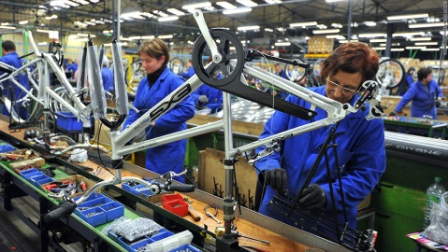
Design for Manufacturability, Safety, & Environment
The Next-Gen Bicycle with Regenerative Braking is designed for maximum rider safety.
Proximity alert
Accident Evidence
Weather Resistant Features
Regenerative Braking with LiO battery
Braking provides clean recharging using kinetic energy
Lithium Ion Battery for maximum recharge capacity
Materials can be recycled
Long term project for mass transportation
Parts are mass produced which will include easy assembly.

Slide 5
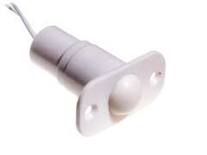
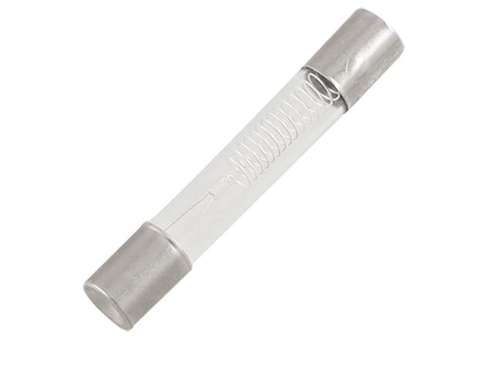
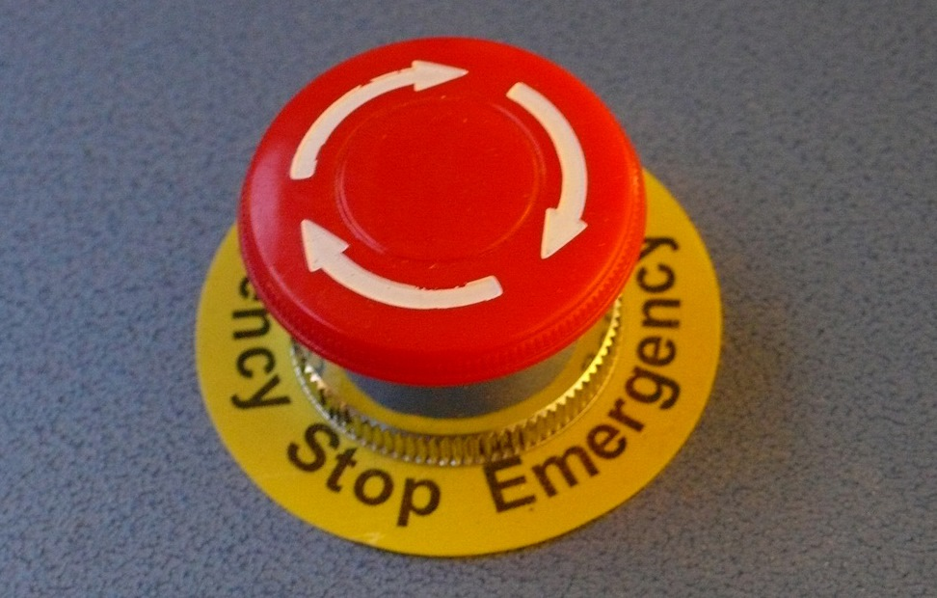
Safety
Door Switch
Emergency Kill Switch
Warning Lights
Fuse
Impact Resistant Polycarbonate

Slide 6
Poly-Creep Tester Design for:
Manufacturability – Parts with Symmetry, Minimize Cutting Tools/Setups
Safety - Automatic shut-off
Environment – Hazardous materials, renewable materials
Reliability – Cyclic life for the grip and rod materials are considered
Maintainability – Components are designed to be easy and quick to replace

Slide 7
Design for:
Manufacturability – Parts with Symmetry, Minimize Cutting Tools, Minimize Setups.
Safety – Special thermocouple sensors for automatic shut-off, special switch for excess displacement on the rods.
Environment – Avoid Hazardous materials, renewable materials, minimum waste production, clear instructions on cleaning/use/repair, mark wear locations on parts.
Reliability – Cyclic life for the grip and rod materials are considered.
Maintainability – Components are designed to be easy and quick to replace.

Slide 8
FMEA for Design (DFMEA) & Process (PFMEA)

Slide 9
 | Failure Modes & Effects Analysis for Designs &/or Processes
 | Part Details | Failure Mode | Severity | Frequency | Detectability | Risk Priority Number | Prosed Action | Reduction in RPN
 | Scales:
 |  | Severity | 1 | Inconvenience
 |  |  | 10 | Injury to Customer
 |  | Frequency | 1 | Rare
 |  |  | 10 | Daily
 |  | Detectability | 1 | Very Visible
 |  |  | 10 | Almost Impossible to Detect
 |  | RPN= Severity*Frequency*Detectability

Slide 10
Rankings of Failure Modes (Instrumented Jet Engine)
Part Details | Failure Mode | Severity | Frequency | Detectability | Risk Priority Number
Frame | Rigidity | 10 | 1 | 3 | 30
Turbine | Efficiency | 8 | 2 | 9 | 144
Transducer | Calibration | 9 | 3 | 2 | 54
Thermocouples | Calibration | 6 | 3 | 2 | 36
Mass Flow Sensor | Calibration | 8 | 3 | 2 | 48
Load Cell | Calibration | 9 | 3 | 2 | 54
Pitot Tube | Deflection | 8 | 2 | 1 | 16
Software | Computer Failure | 8 | 9 | 4 | 288
Wheel Rack | Support Failure | 8 | 1 | 1 | 8

Slide 11
Rankings of Failure Modes Action 1
Part Details | Failure Mode | Severity | Frequency | Detectability | Risk Priority Number | Proposed Action | Reduction in RPN
Frame | Rigidity | 8 | 1 | 3 | 24 | Inspect/Re-weld | 6
Turbine | Efficiency | 6 | 2 | 9 | 108 | Maintenance | 36
Transducer | Calibration | 9 | 3 | 2 | 54 | Recalibrate | 0
Thermocouples | Calibration | 6 | 3 | 2 | 36 | Recalibrate | 0
Mass Flow Sensor | Calibration | 8 | 3 | 2 | 48 | Recalibrate | 0
Load Cell | Calibration | 9 | 3 | 2 | 54 | Recalibrate | 0
Pitot Tube | Deflection | 6 | 2 | 1 | 12 | Brace | 4
Software | Computer Failure | 5 | 9 | 4 | 180 | Debug | 108
Wheel Rack | Support Failure | 7 | 1 | 1 | 7 | Inspect/Re-weld | 1

Slide 12
Rankings of Failure Modes Action 2
Part Details | Failure Mode | Severity | Frequency | Detectability | Risk Priority Number | Proposed Action | Reduction in RPN
Frame | Rigidity | 7 | 1 | 3 | 21 | Brace | 3
Turbine | Efficiency | 5 | 2 | 9 | 90 | Maintenance | 18
Transducer | Calibration | 9 | 3 | 2 | 54 | Replace | 0
Thermocouples | Calibration | 6 | 3 | 2 | 36 | Replace | 0
Mass Flow Sensor | Calibration | 8 | 3 | 2 | 48 | Replace | 0
Load Cell | Calibration | 9 | 3 | 2 | 54 | Replace | 0
Pitot Tube | Deflection | 8 | 1 | 1 | 8 | Replace | 4
Software | Computer Failure | 4 | 9 | 4 | 144 | Performance Testing | 36
Wheel Rack | Support Failure | 6 | 1 | 1 | 6 | Brace | 1

Slide 13
Accelerated Test for Cement &/ or Processes
Part Details21 | Failure Mode | Severity | Frequency | Detectability | Risk Priority # (RPN) | Proposal Action | Reduction in RPN
Tank | Leakage | 9 | 1 | 1 | 9 | Run at lower pressure | 0
Heating Element | Over heat | 9 | 2 | 1 | 18 | Run at lower watage/time | 0
Gasket | Leakage | 7 | 3 | 1 | 21 | tighten to specific torque | 14
Pressure Vavles | Stuck | 9 | 1 | 1 | 9 | Change after a specific runs | 0
Insulation | Improper Insulation | 5 | 2 | 2 | 20 | Proper insulation fitting | 10
Protective Coating | Corrode | 6 | 2 | 1 | 12 | inspect coating after each run | 6
Pressure Gage | Inaccurate pressure reading | 5 | 1 | 1 | 5 | Control test to check accuracy | 0

Slide 14
DFMEA (Next Gen Bike)
Critical Part | Failure Mode | Severity | Frequency | Detectability | Risk Priority Number
Battery | Depleted Charge | 4 | 3 | 5 | 60
Battery | Dislodged | 6 | 2 | 4 | 48
Battery | Violent Discharge (Explosion) | 9 | 1 | 1 | 9
Camera | Disconnection | 4 | 2 | 7 | 56
Camera | Dirty | 2 | 8 | 4 | 64
Frame | Break | 9 | 1 | 1 | 9
Frame | Rust | 8 | 1 | 3 | 24
Computer | Bug/Malfunction | 7 | 4 | 5 | 140
Suspension | Break/Leak | 7 | 2 | 5 | 70

Slide 15
DFMEA Cont.
Critical Part | Failure Mode | Severity | Frequency | Detectability | Risk Priority Number | Proposed Action | Reduction in RPN
Battery | Depleted Charge | 4 | 3 | 5 | 60 | Monitor Charge | 36
Battery | Dislodged | 6 | 2 | 4 | 48 | Inspect/Refasten | 12
Battery | Violent Discharge (Explosion) | 9 | 1 | 1 | 9 | Replace | 0
Camera | Disconnection | 4 | 2 | 7 | 56 | Inspect/ Securely Fasten | 36
Camera | Dirty | 2 | 8 | 4 | 64 | Inspect and clean regularly | 44
Frame | Break | 9 | 1 | 1 | 9 | Avoid large impacts | 0
Frame | Rust | 8 | 1 | 3 | 24 | Minimize biking in the rain/ dry off after rain | 8
Computer | Bug/Malfunction | 7 | 4 | 5 | 140 | Debug/Troubleshoot often | 77
Suspension | Break/Leak | 7 | 2 | 5 | 70 | Inspect/Reseal or replace | 14

Slide 16
DFMEA Cont.
Critical Part | Failure Mode | Severity | Frequency | Detectability | Risk Priority Number
Battery | Depleted Charge | 4 | 3 | 5 | 60
Battery | Dislodged | 6 | 2 | 4 | 48
Battery | Violent Discharge (Explosion) | 9 | 1 | 1 | 9
Camera | Disconnection | 4 | 2 | 7 | 56
Camera | Dirty | 2 | 8 | 4 | 64
Frame | Break | 9 | 1 | 1 | 9
Frame | Rust | 8 | 1 | 3 | 24
Computer | Bug/Malfunction | 7 | 4 | 5 | 140
Suspension | Break/Leak | 7 | 2 | 5 | 70
Critical Part | Failure Mode | Severity | Frequency | Detectability | Risk Priority Number
Battery | Depleted Charge | 4 | 2 | 3 | 24
Battery | Dislodged | 6 | 2 | 3 | 36
Battery | Violent Discharge (Explosion) | 9 | 1 | 1 | 9
Camera | Disconnection | 4 | 1 | 5 | 20
Camera | Dirty | 2 | 5 | 2 | 20
Frame | Break | 9 | 1 | 1 | 9
Frame | Rust | 8 | 1 | 2 | 16
Computer | Bug/Malfunction | 7 | 3 | 3 | 63
Suspension | Break/Leak | 7 | 2 | 4 | 56

